Slide 1
Maintaining Your Mental and Emotional Health While Job Hunting
Sarah Withee
@geekygirlsarah
Please tweet along with #SelfConf

Slide 2

Hello!
I’m Sarah Withee
Polyglot software engineer at Arcadia.io
You can find me at @geekygirlsarah
Notes:
I’m Sarah, software engineering at Arcadia
Arcadia does data analytics on population healthcare records
Please feel free to tweet along, I want to see more mental health in tech tweets

Slide 3
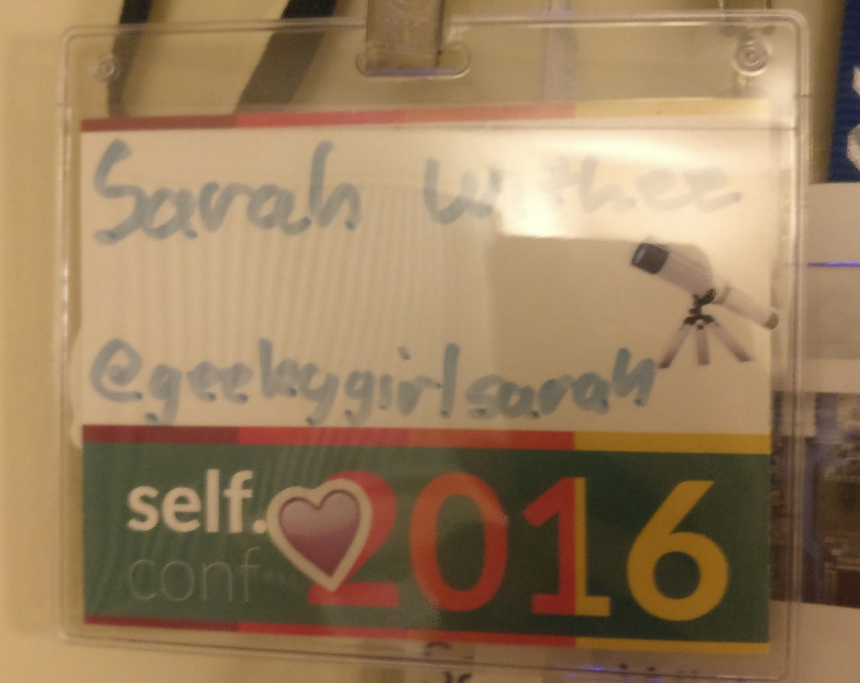
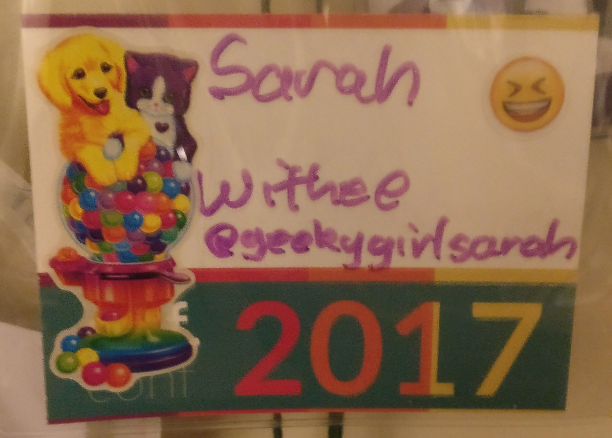
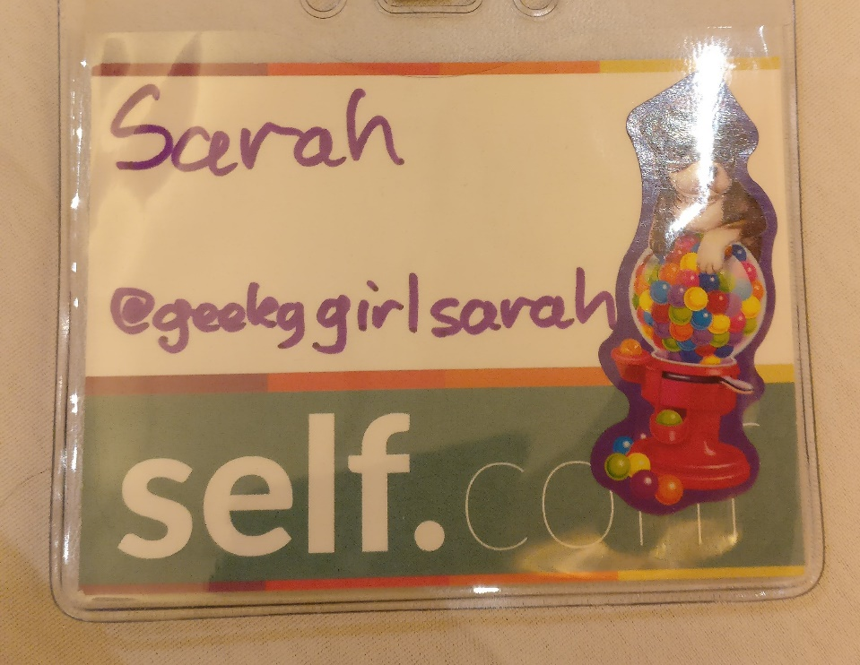
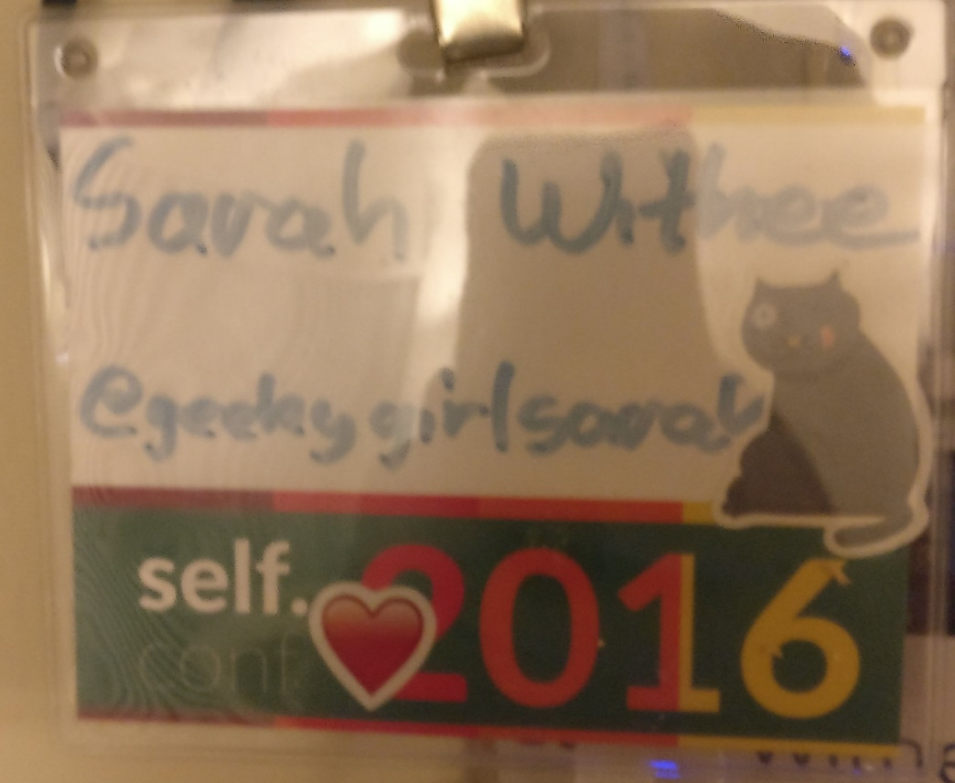

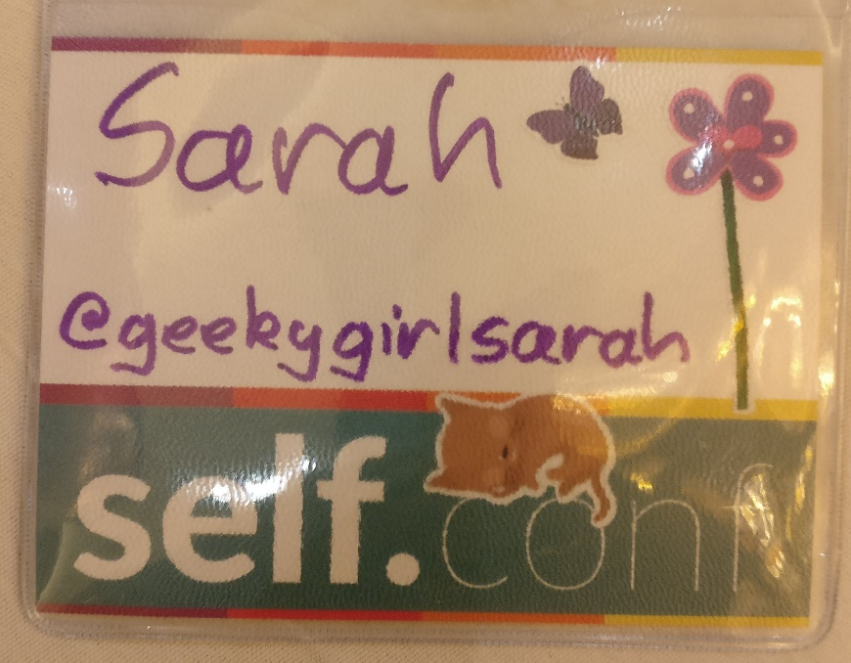
Notes:
It’s my third SelfConf
Showing off nametags
I’m excited to end our Friday with everyone’s favorite topic:

Slide 4

JOB HUNTING !!!!!!
Notes:
JOB HUNTING!
Or maybe…

Slide 5

JOB HUNTING !!!!!!
Notes:
JOB HUNTING!

Slide 6
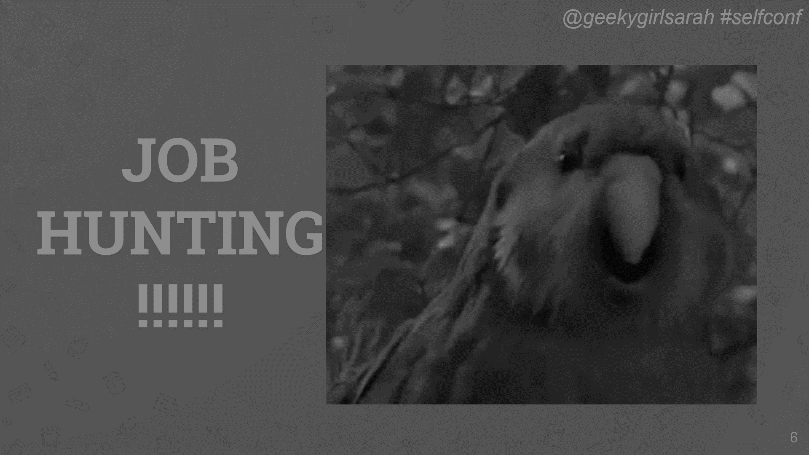
Notes:
Or not….

Slide 7
Part 1.
Job Searches are Terrible
… and I lived to tell the tale
Notes:
My story
I always wanted to be a software developer, it’s been a life-long goal.
I got several jobs, and each time I had to leave for some reason. (Bad work, bad culture, red flags, etc.)
But with the last job I realized something different: It wasn’t an inherently bad job… but it wasn’t for me.
What happened? My mental health went down. Slowly at first, almost where I didn’t notice it. But faster and faster

Slide 8
I had not set myself up for success with that job
Didn’t have a strong resume
Didn’t know what the work actually involved
Culture wasn’t described well to me
Devs were lower on totem pole
… but it wasn’t my fault!
Notes:
I realized I had not set myself up for success with that job.
I didn’t go in with a strong resume showing my real skills (I looked a lot more inexperienced or less skilled, affected my salary)
I didn’t find out what the real work was ahead of time, and I wasn’t challenged really at all
I found they had a particular culture that wasn’t described to me very well when I was interviewing
It was an environment where the devs were so few compared to other employees that we weren’t cared about as much as scientists/others at the job
I needed a place to thrive, and I didn’t have it. Wasn’t learning from others, wasn’t helping others learn
It wasn’t my fault… but it wasn’t there fault either.

Slide 9
This rubbed off on my mental health
My work quality got bad
Notes:
This ended up rubbing off on my mental health, and work quality got bad.
That ended up getting them to the point of wanting to fire me, but perhaps not before I was about to rage quit. (A few friends talked me out of it)
Seriously, I nearly held a party after the 1:1 I thought my manager was going to fire me. He didn’t.
I ended up telling him that I was job hunting and… he said he was going to support me.

Slide 10
WHAT!?!?!??!
Notes:
WHAT!?!?!?!?!?
Seriously…. He wanted to do whatever he could to support me. And so did the rest of the chain up. My manager wished me luck on a trip to an interview (and I didn’t even tell her). Her director knew and was ok with it. And I had a meeting with the Director of HR and he literally told me they wanted to keep me while I job searched.

Slide 11
HUH!???!!!?!?
Notes:
HUH???
Long story short, they kept me while I searched for a while, and at some point we both mutually decided it was best to move on.
6 months of the last job hunt was while employed, 2 months of it was not.
And I realized WAY more about myself and what I needed to do on this job hunt than I ever knew before.
This talk is a combination of my experiences and realizations from this, combined with research

Slide 12
Part 2.
Prepping for the Job Hunt
Notes:
If nothing else, if you fall asleep, at least take this in:

Slide 13
tl;dr
It all boils down to self care
Notes:
tl;dr It all boils down to self care

Slide 14


Self Care
Notes:
It’s bubble baths and retail therapy days right?
(maybe not)

Slide 15


Self Care
Notes:
Or video game or binging on TV shows while eating ice cream for hours, right?
(maybe not…)

Slide 16
“Caring for myself is not self-indulgence. It is self-preservation, and that is an act of political warfare.”
-- Audre Lorde
Notes:
A great quote by Audre Lorde: “Caring for myself is not self-indulgence. It is self-preservation, and that is an act of political warfare.”
Whoa… bubble baths just got deep.
The International Self-Care Foundation (yes, it’s a real thing) has done years of research.
Some groups have identified 139 definitions of self care. (No wonder it’s confusing)

Slide 17
7 Pillars of Self Care
Knowledge & health literacy
Mental well-being, self-awareness, agency
Physical activity
Healthy eating
Risk avoidance or mitigation
Good hygiene
Rational & responsible use of products/services
Notes:
They found 7 main categories that are a good overall description of what that is. They call them the…

Slide 18
1. Knowledge & Health Literacy
The cognitive and social skills which determine the motivation and ability of individuals to gain access to, understand and use information in ways to promote and maintain good health
Notes:
Knowledge & health literacy
The cognitive and social skills which determine the motivation and ability of individuals to gain access to, understand and use information in ways to promote and maintain good health
Why is this important? People with strong health literacy skills enjoy better health and well-being.
Those who don’t know these skills tend to have riskier behaviors.
They also know when stuff is healthy or misleading.

Slide 19
2. Mental well-being, self-awareness & agency
Mental well-being: life satisfaction, optimism, self-esteem, mastery and feeling in control, having a purpose in life, and a sense of belonging and support
Notes:
Mental well-being, self-awareness & agency
Mental well-being: life satisfaction, optimism, self-esteem, mastery and feeling in control, having a purpose in life, and a sense of belonging and support

Slide 20
2. Mental well-being, self-awareness & agency
Self-awareness: personal, practical application of an individual’s health knowledge to their own health situation
Notes:
Self-awareness: personal, practical application of an individual’s health knowledge to their own health situation
Sneezing/coughing/fever/etc. is one thing, saying “I have a cold and I need to rest and etc.” is better

Slide 21
2. Mental well-being, self-awareness & agency
Agency: capacity and the intention of an individual to take action based on their knowledge and awareness of their particular situation and condition – physical and mental
Notes:
Agency: capacity and the intention of an individual to take action based on their knowledge and awareness of their particular situation and condition – physical and mental.
What is your situation? What does that mean you need to do?
Why is this important? They provide the basic starting position for all future self-care activities.

Slide 22
3. Physical activity
Physical activity is defined as any bodily movement produced by muscles that requires energy expenditure.
Notes:
Physical activity
Physical activity is defined as any bodily movement produced by muscles that requires energy expenditure.
It is essential to good health, and regular exercise can reduce the risk of many non-communicable diseases.
Regular moderate-intensity physical activity – such as walking, cycling, or participating in sports – significantly improves health, fitness and mood.
“Moderate” though… moving is better than not moving. No marathons needed to do that.
Expending energy is the most important part. Find a way to do that

Slide 23
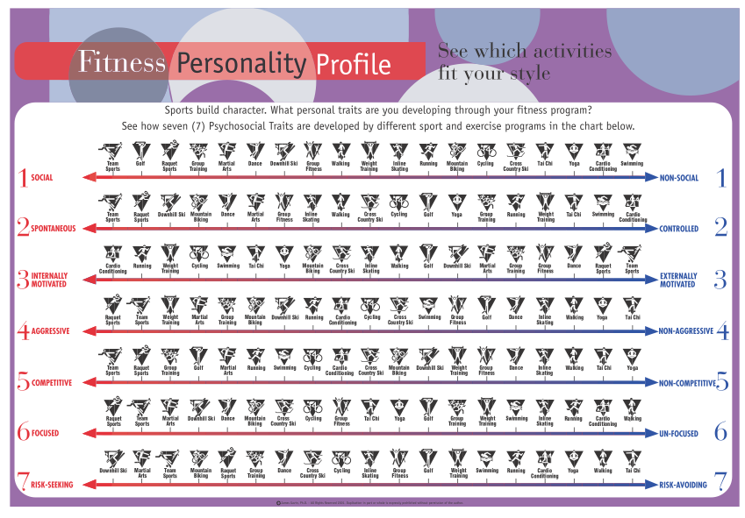
3. Physical activity
Notes:
Social
Spontaneous
Internally motivated
Aggressive
Competitive
Focused
Risk-Seeking

Slide 24
4. Healthy eating
Diet plays a role in self-care, maintaining health and reducing the risk of diet-related non-communicable disease
Notes:
Healthy eating
Diet plays a role in self-care, maintaining health and reducing the risk of diet-related non-communicable disease.
Healthy eating is important because diet is considered one of the two primary risk-factors for non-communicable disease.
Maintaining a healthy diet has been repeatedly shown to have preventative benefits

Slide 25
5. Risk avoidance or mitigation
Risk mitigation, in terms of health, refers to the avoidance or reduction of behaviors that directly increase the risk of disease or death.
Notes:
Risk avoidance or mitigation
Risk mitigation, in terms of health, refers to the avoidance or reduction of behaviors that directly increase the risk of disease or death.
Making sure you are vaccinated
Not smoking (or if you do, quitting)
If you drink alcohol, drinking in moderation
Protecting yourself from the sun
Driving carefully and wearing a seat belt
Wearing your helmet when you ride a bicycle
Behaviors that reduce health risks are often some of the most achievable self-care practices.

Slide 26
6. Good hygiene
Hygiene refers to the conditions and practices that help to maintain health and prevent the spread of diseases.
Notes:
Good hygiene
Hygiene refers to the conditions and practices that help to maintain health and prevent the spread of diseases.
Good hygiene therefore includes practices for preservation of health
Maintaining a clean living and working environment, washing hands, etc.
Good hygiene is important because it increases health, well-being and economic productivity.
Inadequate sanitation impacts individuals, households, communities and countries.

Slide 27
7. Rational and responsible use of products/services
It involves safely and effectively managing their health and everyday conditions with medicines, products or services.
Notes:
Rational and responsible use of products/services
It involves safely and effectively managing their health and everyday conditions with medicines, products or services.
Self-care products and services are the ‘tools’ of self‐care, supporting healthy practices, and may include the use of:
Prescription medicines (in conjunction with a doctor)
Preventative health products, e.g. dental care, mosquito netting, sleep aids
Devices and diagnostics, e.g. home blood pressure monitors
Wellness/health services, e.g. nutrition planning, gym memberships, acupuncture, chiropractic care, therapy, etc.
Using the “tools” of self care helps you maintain health and wellness.
Rational and responsible use of products or services can help delay or prevent the development of many conditions and encourages greater independence in managing any illness that does develop.

Slide 28
… In Other Words…
These 7 pillars help you maintain mental and physical health, which in turn helps reduce stress, anxiety, increase concentration, etc.
Notes:
So in other words… These 7 pillars help you maintain mental and physical health, which in turn helps reduce stress, anxiety, increase concentration, etc.
All things needed in job hunting.

Slide 29
Physical Health
Mental Health
Notes:
These are cyclic… when you take care of mental health, it supports your physical health. When you take care of physical health, it helps your mental health.
The hardest part of me starting to work out again 3 weeks ago was literally convincing myself to put on workout clothes, grab a water bottle, leave my apartment, and go work out.

Slide 30
Self care is relative
Notes:
These are all relative… I told you nothing specific about your life. You need to figure out what these mean to you.

Slide 31
7 Pillars of Self Care
Knowledge & health literacy
Mental well-being, self-awareness, agency
Physical activity
Healthy eating
Risk avoidance or mitigation
Good hygiene
Rational & responsible use of products/services
Notes:
These are all relative… I told you nothing specific about your life. You need to figure out what these mean to you.

Slide 32
Incorporate Pillars into Your Live
Take breaks from work (away from desk)
… especially if you’re remote
Strategize what relaxes you
Strategize how to unwind
Notes:
Taking breaks from work (including away from your desk)
This helps with mental health
Sometimes my 15 minute walks would save hours of stress if I stayed at my desk trying to work on it
… especially if you work remote
Your home is your work
Home becomes that stressful workplace
For me, I literally can’t work at home. I’m too distracted, which then stresses me out because I have more work to do later. I HAVE to leave.
You can’t go home to relax
Take time to strategize what relaxes you (smells, baths, calming music, etc.)
I found warm bath soaks, sitting by bodies of water and listening to the waves, and calming sounds can help me relax
Take time to strategize how to unwind (exercise, journaling, TV/video games, etc.)
My guilty pleasure is Grand Theft Auto. I only play this when super stressed.
I can also unwind by going on walks (help my brain process) or bicycling (gets out some intense energy and feels great going fast)

Slide 33
Incorporate Pillars into Your Live
Strategize how to escape reality
Go easy on yourself
Take time for a hobby
Take time to try to get some good foods
Notes:
Take time to strategize how to escape reality (meditation, yoga, walks, movies or video games in moderation)
Video games work great for me
I can escape with dinner with friends, seeing movies, and going for long drives too.
Go easy on yourself. (If you mess up or forget things, it’s fine! Do it next time.)
You’ll probably immediately think how this can apply to job hunting
Realizing interviews are only a moment in time is really helpful on this
Photo frame of a happy couple is only a moment in time. They may not always be happy, or even always together
Job interviews are a moment in time. You’re not always 100% on your A-game, and so some interviews are just not going to go amazingly well
This is fine! There are more interviews where that came from. Your mental health is not worth obsessing on how something went wrong.
I get this is harder for some anxiety-prone people, but maybe you can journal it out or find some other outlet.
Take time to a hobby.
You’re usually looking for a job faster than slower, but allocating time for this can help you feel better
Having a thing you enjoy doing will help your brain in the long run, but also can help you relax, which helps physical feels too
Take time to try to get some good foods
Let’s face it, it’s hard to diet properly
If you can make 2-4 meals a week that are a bit healthier, that’s a start
Don’t aim for super “healthy”, aim for enjoyable but homemade. The more ingredients you mix yourself, the better for you it is.
Just think: A burger made at home is always healthier than that McDonald’s burger.

Slide 34
Part 3. Self Care in Specific Scenarios
Notes:
Specifically, we can do things to better prepare ourselves mentally (Here are some specific situations)

Slide 35
Going Through a Bad Job
Find ways to leave the space
Change what you can
Try to accept things you can’t change
Remember it’s just work
Notes:
Find ways to try to leave the space every so often (walks, eat a snack with good coworkers, etc.)
At the last job, I had to leave at least a couple of times a day to try to clear my head
Change what you can (can you talk to managers? Can you make subtle changes to your workspace? Can you work in a different room sometimes?)
For a while I tried to print out happy things and put them in my cube.
Can you change your tasks?
Oddly enough, even going to the occasional interview phone call/skyped helped break up the monotony of my day tasks.
My manager took me off a project and had me fix some bugs on another project instead. This actually helped a lot.
Try to accept the things
WAY harder than it sounds
Sometimes our minds can be talked into things
Maybe you can tolerate it if you start to think about it as a temporary situation (what I had to do)
Work pays you, work doesn’t own you. Even if it feels like it, you are not a slave.
Remember it’s just work. It’s 8 out of 24 hours of your day. Again, not worth your mental health for something so small in the grand scheme of things.

Slide 36
While Unemployed
Get dressed! In clean clothes! Maybe dress up!
Leave the home
Treat applying for jobs like a job
Notes:
Get dressed! In clean clothes! Maybe even dress up!
The stereotype is working at home in your pajamas, but…
Studies show that people who dress nicer, even while at home, mentally do better at work
Clean clothes will help with hygiene (a pillar)
This may be more important for remote people where it’s easy to slack on this.
Silk suit pyjamas (HIMYM)
Maybe it just means a button-up shirt with your yoga pants
Feel more put together.
I fight this constantly. I feel better in more dressier, more feminine clothes.
Tech is t-shirts, shorts, and flip flops
It’s a hurdle, but once I start dressing up, I DO feel more awesome, which affects my work
I think levelling up my clothes when I felt worse about my job helped
It’s also why I’m wearing nice stuff on stage too. I feel more awesome.
If it’s a video call, you’ll look more awesome too.

Slide 37
While Unemployed
Get dressed! In clean clothes! Maybe dress up!
Leave the home
Treat applying for jobs like a job
Notes:
Leave the home
Staying at home more than normal will probably contribute to lazy feelings or unproductivity.
Go to libraries, coffee shops, friends’ houses, local colleges/universities, etc. to apply for jobs
Try to treat applying to jobs like a job
Restrict it to a time limit. Time box it.
Don’t do it at home if you can help it, so you can go home when you’re done
Make it a goal, or gamify it. Give yourself a criteria for doing it. Ex: 6 applications a week, or subtract for each interview. Have a reward for accomplishing this. Drag others into it too and try to have incentives for you all to do more applications/interviews.
Treating this as a thing you do every day, like a routine, makes it less all-encompassing to your brain.
Take breaks! You don’t do work all in one 8-hour chunk, why do this?
I limited myself to one code screen interview a day.
Project management… make each job application a small project, and try to manage its flow like such.
For me, visually watching my jobs progress across my Trello board, and seeing I had several interviews in progress FELT like good progress.

Slide 38
While Job Interviewing
Interviews are to find the right employee…
… but for you to find the right job
Find out what the process is
Interview processes reflect team/company dynamics
Prepare, but don’t over-prepare
Notes:
Remember they’re about determining the right candidate…
… but also if the job is right for you
Are they grilling you? Grill them back.
It’s important you know what you’re getting into
Don’t donate your energy. The interview shouldn’t suck only YOUR energy out.
I see so many things about the 50+ questions you can ask. Go in prepared with some questions to ask, but ask what’s most important to you, even if it’s not tech-specific (do they provide snacks? May be more important than what version control system they use)
You have to do work, but you have to work with people. Find out both about the work you would do AND about the types of people you work with AND the company’s feel
Square’s interviews were amazing because every time I asked someone else about culture or favorite company things, people had different answers, but it told me without a doubt this would be a place where I would thrive to work, no matter what tech that was.
More data points tell you more. Ask many of the same questions of everyone.
Ask about their challenges. Transparency is important. (If they don’t have challenges, run. They’re just hiding them and it’s probably a trash fire. Yes, I talked to companies like this.)

Slide 39
While Job Interviewing
Interviews are to find the right employee…
… but for you to find the right job
Find out what the process is
Interview processes reflect team/company dynamics
Prepare, but don’t over-prepare
Notes:
Find out what the process is like. An hour with one person? 3 hours with a panel? Coding? Is this a manager or developer or designer or recruiter you’re talking to? Why be surprised going in?
Interview processes often reflect team/company dynamics. If it’s terrible and you’re rejected, it’s likely the job wouldn’t have worked well for either of you (and that’s perfectly fine).
Prepare, but don’t over-prepare. You may need to brush up on materials, but if you have to full on study for a college final in a week, it’s probably a bad job interview. (Not saying you shouldn’t though.)

Slide 40
In General
Go in knowing what you want out of the job
Know your deal-breakers
Get your resume ready
Schedule time to take care of errands
Limit yourself, both in time and in numbers
Take time to take notes post-interview
Notes:
Go in knowing what you want out of the job
Do you want more money? Good work challenges? Great healthcare? Ability to take your dog to work? You probably can’t have it all but you can have the most important ones
Also deal breakers. What can you absolutely NOT deal with in a company and if it comes up, you know to walk away immediately?
Get your resume ready. Not just updated, but have friends look at it. Have other industry people look at it. Get it professionally reviewed. Make it show you off like the amazing person you are.
Schedule time to take care of things you need to do (household chores, taking baths, making food, etc.). Think like work meetings.

Slide 41
In General
Go in knowing what you want out of the job
Know your deal-breakers
Get your resume ready
Schedule time to take care of errands
Limit yourself, both in time and in numbers
Take time to take notes post-interview
Notes:
Limit yourself, both in time and in numbers. You can’t do as many interviews as possible in a small time frame. You have limits, accept them.
I couldn’t do more than 1 a day without feeling like future interviews that day would suffer.
Take a little bit after each one to maybe write down some notes. Reflect on how it went, and then put it aside and move on. Learn from your mistakes but don’t obsess on them.

Slide 42
In General (cont.)
Remind yourself of your successes
If you get an offer, don’t sign it! Take your time
Trust your gut and back away if needed
Notes:
Remind yourself of your successes. Make lists of things you accomplished at old jobs, side projects you did, awards you earned in your education, etc. You may not share all of them, but having them is beneficial for future storytelling purposes.
If you do get an offer, take your time! Don’t sign it! The default feeling is SIGN IT NOW! but take some time to read it, reflect on everything you know about them, ask additional questions, and anything else you need to do. You never have to take the first offer, and you usually have at least a week to reflect on it.
If you do get one and are actively interviewing other places, let them know you have an offer and they can rush their interviews to help expedite the process.
At any point, does it feel weird? Gut telling you it’s a bad place? Back away. No point in undue stress just to see how far you’d get for a bad place. Respectfully say you’re backing out of the interview process. I’ve done that a few times too.

Slide 43
Part 4. Tools for the Hunt

Slide 44
Tools for the Hunt
Confidence (or fake confidence)
“I’m awesome!”
”I’m good at what I do”
Use that successes list to remind you that you’re good at what you do
No one’s perfect, and that’s fine
Ignore imposter syndrome
Notes:
“I’m awesome”
Say it out loud!
(No really, I am!)
“I’m good at what I do”
Say it out loud!
(No really, I am!)
Use that list you made to remind yourself that you ARE good at what you do
This helped me a lot. I wasn’t faking my successes but was reminded of when I wrote good code, solved complicated problems, helped others with their problems, architected stuff that seemed impossible to build, and more.
It helped me realize I was a wonderful developer, and any job should be proud to have me working on their problems. And my last job didn’t make me thrive or have problems they were putting me on. And I can be awesome without this job being great for me.
No one’s perfect, and that’s fine. You can be a great employee without being perfect.

Slide 45
Tools for the Hunt
Confidence (or fake confidence)
“I’m awesome!”
”I’m good at what I do”
Use that successes list to remind you that you’re good at what you do
No one’s perfect, and that’s fine
Ignore imposter syndrome
Notes:
Ignore imposter syndrome
Am I good enough to work for Amazon? I’d say no, but I did a code challenge that didn’t work, found out their system sucked, interviewed with a person, they didn’t hire me but they passed me around to other teams. After the 4th team to talk to me, I made it to Seattle for an in-person interview. I didn’t make it in, but it doesn’t mean I’m not good enough.
Am I good enough to work for Microsoft? I’d say no, but I talked to a recruiter, got passed around a couple of times, then landed with the cloud developer advocate team. They described it as kind of this perfect blend of what I loved to do. They actually personally called me back to say they loved me, and I just lacked one bit of experience. Am I a bad developer? No… if I learn a tiny bit more Azure they would have hired me then. (Several people on that team later told me I would have been a perfect fit.)
Am I good enough to work for Google? I’d say no, but a recruiter found me, I passed the screen then FAILED the tech interview miserably. I almost told them halfway through I was just going to end early it was going that badly. They gave me a second chance, and I ROCKED that one with flying colors. How can I be a super terrible person who clearly can’t do it AND super rockstar awesome that is perfect Google material at the same time? I made on-site and am proud of my work, even though they didn’t hire me.
Am I good enough to work for Square, Etsy, StitchFix, MongoDB, IBM, New Relic, Twilio, Akamai, and more? I’d probably say no but… you know what? Yes! And maybe you are too.
Be proud of your work, past and present. On every interview, remind yourself YOU made it this far. Celebrate that rather than where you failed.

Slide 46
Tools for the Hunt
A notepad
Take notes in interview
Store questions up for later
Track interviews
Remember what they asked
Notes:
“Huh?”
Use it to take notes while in the interview of answers to questions, things you notice, etc.
Track date/time of interviews, write down tech questions so you can try to solve later if you want, etc.
Use it to write questions as you think of them, then ask them later when you have time to

Slide 47
Tools for the Hunt
Sites for jobs and data
Glassdoor (interview questions, reviews)
Linkedin Jobs, Payscale (salary comparisons)
Dice, Underdog.io, TripleByte, The Muse, Stack Overflow, Github (job listings)
WeWorkRemotely (remote jobs)
Notes:
Glassdoor (interview questions, company reviews, etc.)
LinkedIn Jobs, Payscale (salary comparisons and valuations)
Dice, Underdog.io, TripleByte, The Muse, Stack Overflow, Github, etc. (job listings)
Weworkremotely (finding remote jobs)
Hire Tech Ladies, PowerToFly (women’s job postings)
Twitter or social media (can find job postings too)

Slide 48
Tools for the Hunt
Sites for jobs and data (cont.)
Hire Tech Ladies, PowerToFly (women jobs)
Twitter, social media (talk to people, find jobs)
Notes:
Glassdoor (interview questions, company reviews, etc.)
LinkedIn Jobs, Payscale (salary comparisons and valuations)
Dice, Underdog.io, TripleByte, The Muse, Stack Overflow, Github, etc. (job listings)
Weworkremotely (finding remote jobs)
Hire Tech Ladies, PowerToFly (women’s job postings)
Twitter or social media (can find job postings too)

Slide 49
Tools for the Hunt
Networking
Meetup (local tech langs/frmwrks, social grps)
LinkedIn (where connections work, do people stay)
Twitter/social media (follow, chat w/people)
Conferences (job opportunities)
Friends (support)
Notes:
Meetup (local tech langs/frameworks, or social tech groups)
It’s sometimes daunting, but even talking to one person can open connections
LinkedIn (go see where your connections work and what they think, also look up companies and look at their employees. Maybe they leave regularly? Maybe they stay around? Good things to say?)
Twitter or social media. You can follow anyone and chat with them, why not find out about their companies?
Conferences (may be expensive, but scholarships/diversity tickets) are usually FULL of job opportunities floating around. And usually they have employees there that you can ask about the positions/companies too.
Friends! Not only are they reassuring, but they’re great support for the interview process, and can help remind you that you’re better than you think you are.

Slide 50
Tools for the Hunt
Job Tracking
Trello
Post-it notes
Spreadsheet

Slide 51
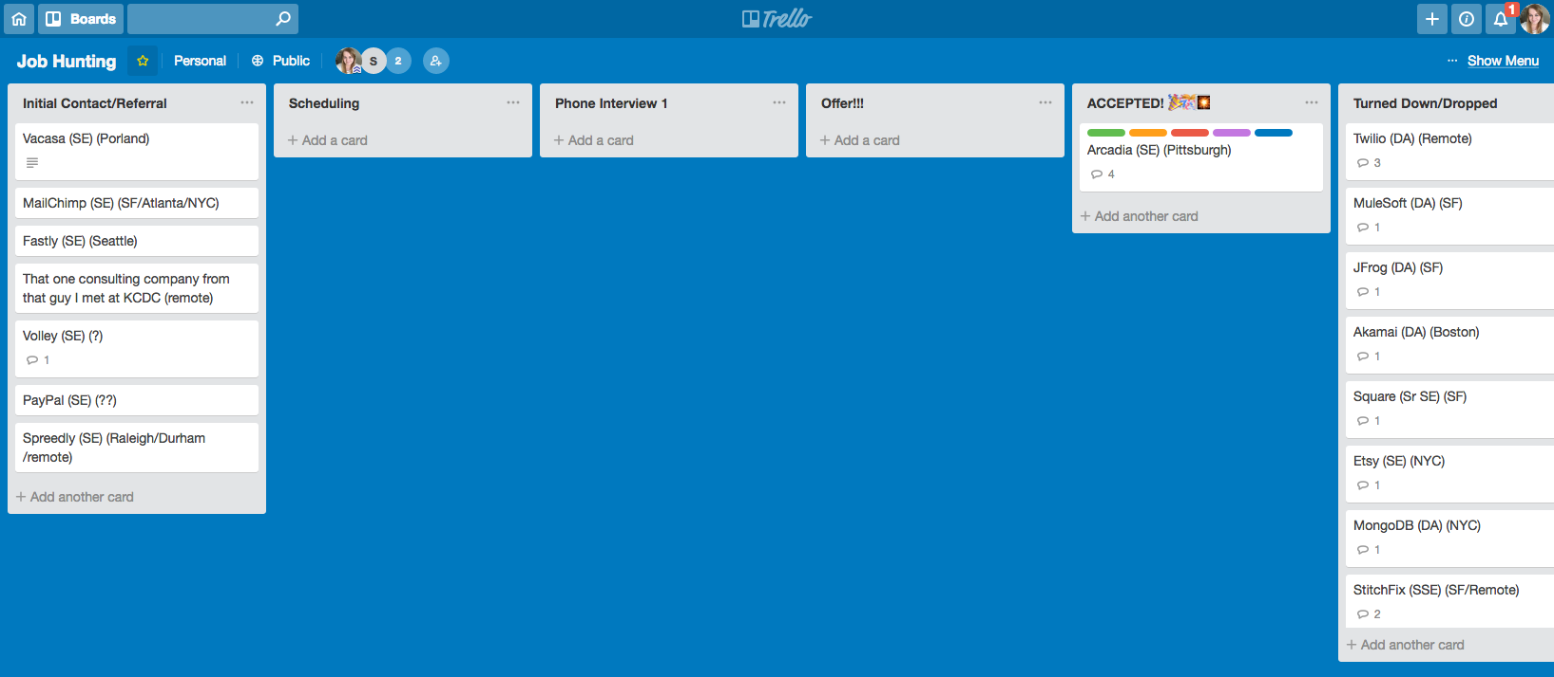
Tools for the Hunt

Slide 52
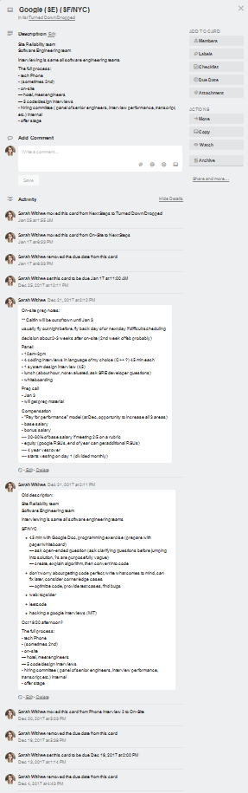

Slide 53
Part ?. What Can Companies Do?

Slide 54
What Can Companies Do?

Slide 55
In Conclusion
Notes:
So much stuff….

Slide 56
Conclusion
Job hunting and interviews are exhausting
Use a variety of self care techniques to prepare
Make personal strategies before the hunt
Notes:
Job hunting and job interviews are EXHAUSTING and can beat us down more than we’d like
Using a variety of self care techniques, you can prepare yourself before, during, and after to make them more easily doable
Take time to make personal strategies before you continue (or start) your job hunt

Slide 57
Thanks!
Slides: geekygirlsarah.com/job-hunt
Twitter - @geekygirlsarah
Email – hello@sarahwithee.com
Find me later!
Notes:
I’m Sarah Withee
Geekygirlsarah on Twitter
I’d love to hear what worked or didn’t for you. Come find me in the hall, after this talk, or tomorrow
Pleas share this with your friends and other job seeking friends. Help them succeed too!
Thank you!

